Slide 1
Day-6
By Aksadur Rahman
aksadur@yahoo.com

Slide 2
Agenda
Sql server join types
Inner join
Left Join
Right Join
Full Join
Union
Union all
Intersect
Except

Slide 5
Union vs Join

Slide 6
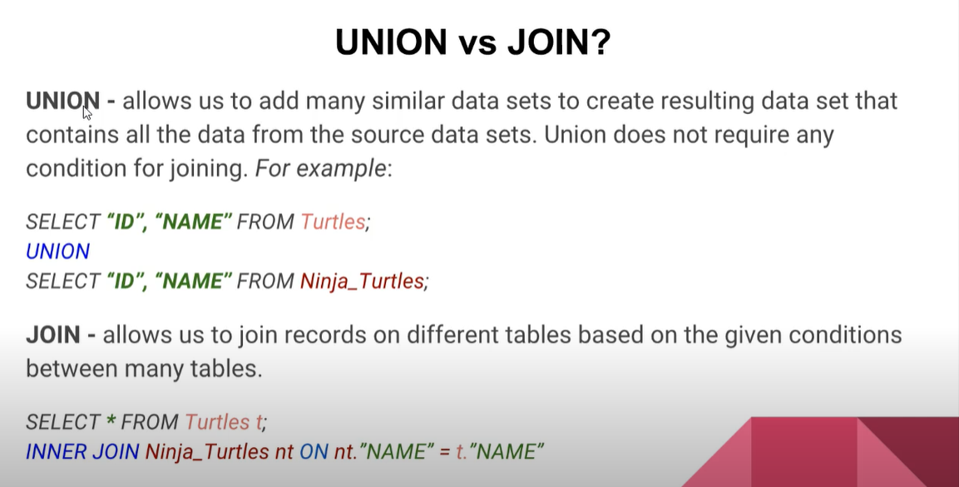

Slide 7
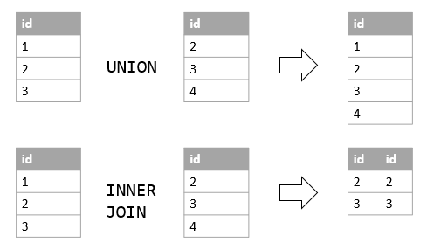
Union vs Join

Slide 8
Union/Union All/Intersect/Except

Slide 9
The SQL UNION Operator
The UNION operator is used to combine the result-set of two or more SELECT statements.
Every SELECT statement within UNION must have the same number of columns
The columns must also have similar data types
The columns in every SELECT statement must also be in the same order
SELECT FirstName FROM Patient
UNION
SELECT FirstName FROM Guardian
ORDER BY FirstName

Slide 10
UNION ALL
UNION selects only distinct values. Use UNION ALL to also select duplicate values!
SELECT FirstName FROM Patient
UNION ALL
SELECT FirstName FROM Guardian
ORDER BY FirstName

Slide 11
Intersect
SELECT FirstName FROM Patient
INTERSECT
SELECT FirstName FROM Guardian
ORDER BY FirstName

Slide 12
Except
SELECT FirstName FROM Patient
EXCEPT
SELECT FirstName FROM Guardian
ORDER BY FirstName

